Slide 1
Connections
Find the connection between the 4 seemingly random clues.
The earlier you find the connection the more points you get!

Slide 2
Connections - Example
What’s the connection between…
5 points
3 points
2 points
1 point
England
Wales
France
Italy
Compete in Rugby 6 Nations championship

Slide 3
Connections
What’s the connection between…
5 points
3 points
2 points
1 point
V shaped valley
Truncated spur
Flood plain
Estuary
River features in order along course

Slide 4
Connections
What’s the connection between…
5 points
3 points
2 points
1 point
Dartmoor
New Forest
The Broads
Peak District
Areas with National Park status in England

Slide 5
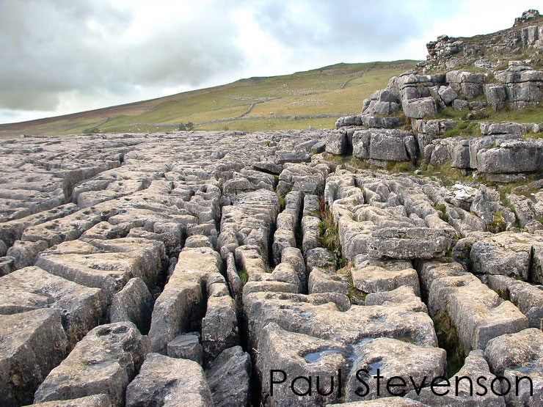
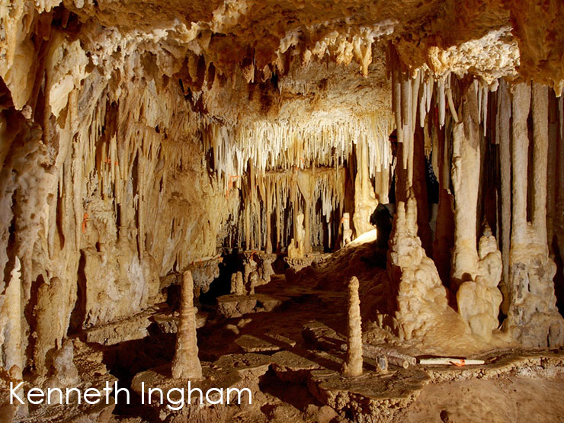
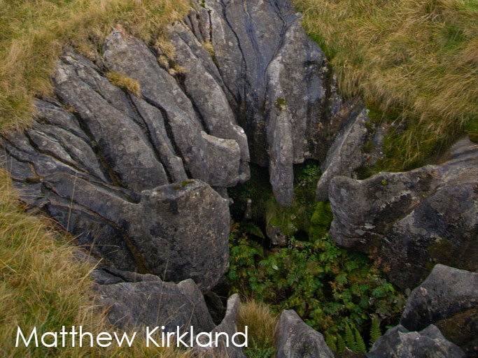
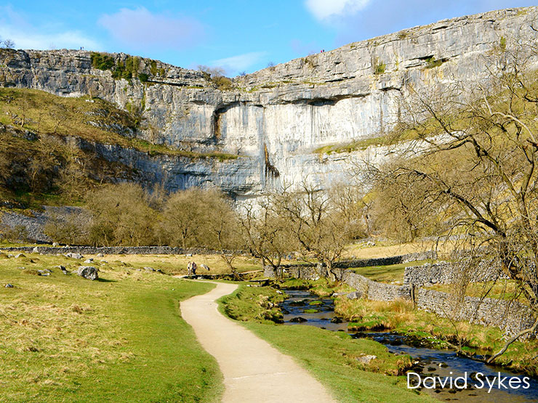
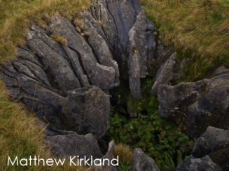
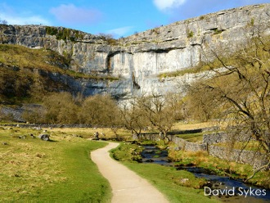
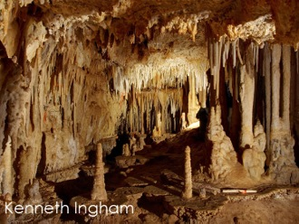
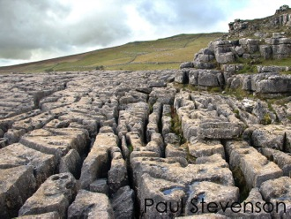
Connections
What’s the connection between…
5 points
3 points
2 points
1 point
Limestone features
Notes:
Swallow hole: Matthew Kirkland - https://www.flickr.com/photos/simpologist/300023368 – image cropped
Limestone pavement: Paul Stevenson - https://www.flickr.com/photos/pss/412537208 – image cropped
Malham Cove: David Sykes - https://www.flickr.com/photos/dsykes34/6865590364 – image cropped
Cave: Kenneth Ingham - https://www.flickr.com/photos/keninghamphoto/8242725267 – image cropped

Slide 6
Connections
What’s the connection between…
5 points
3 points
2 points
1 point
Countries with unique last letters
Notes:
Flags from Wikipedia
The only countries which end with the letter shown on the flag – these are the only 4 countries to do so as well.

